Slide 1
SAFTY السلامة في المختبرات

Slide 2
What are the most important safety ؟ measures in laboratories
1-The lab coat should be worn
2-Gloves and masks should be worn in dangerous trials
3-Hand washing after testing
4-Conduct experiments inside the poison booth
5-Avoid wearing open shoes because chemicals may fall directly on the skin of the foot.

Slide 3
6- Take care not to eat or drink in the laboratory.
7- Ensure the presence of first aid bags.
8- Ensure the presence of the necessary detergents, such as soaps, laundries, and tissues.
9- Attention to the existence of sources to ventilate the place.
Avoid smoking in the laboratory. 10-

Slide 4
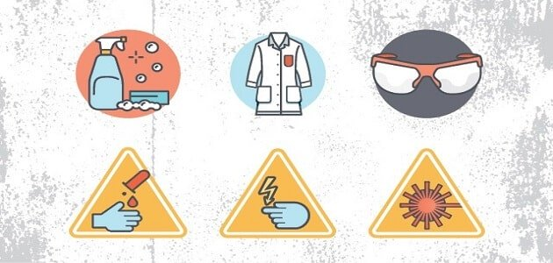

Slide 5
Chemical warning signs

Slide 8
Carcinogen

Slide 10
Before leaving the laboratory
1- Clean the workplace.
2-Wash the glass used in the work.
3-Close all unnecessary appliances and equipment (electricity, water, gas, vacuum).
4-It removes any leftovers with chemicals lying o the ground.
5-Leave the windows for the gas extraction cabinet open.
6-Turn off all lighting points.
7- Close the laboratory doors

Slide 11
Chemical tools

Slide 12
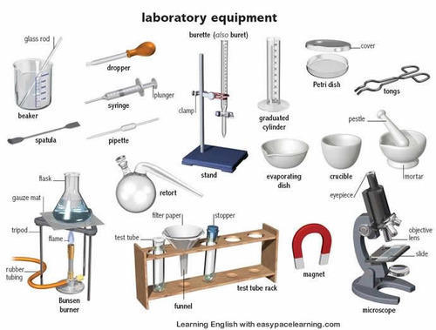

Slide 13
Chemical tools
1- beaker
2- cylinder
3- test tube
4-round
5-rack
6-water bath
7-tonk

Slide 14
8-dropper
9- funnel
10-pipete
11- burette
12- Volumetric flask

